Slide 1
Guidelines
Kindly use the given template for submitting your prototype(Make a copy of the template)
One team is only required to submit one project.
Follow this template while preparing your presentation.
You are welcome to add as many POCs and design concepts to support your project.
The project should be feasible and the team members should be capable enough, to come up with the fully functioning prototype of the same idea, if required.
In case of queries, kindly reach out to us at solutionchallengesupport@hack2skill.com
Note: Prototype must include cloud deployment and use at least one Google AI model or service (e.g., Gemini) as part of the solution.

Slide 2
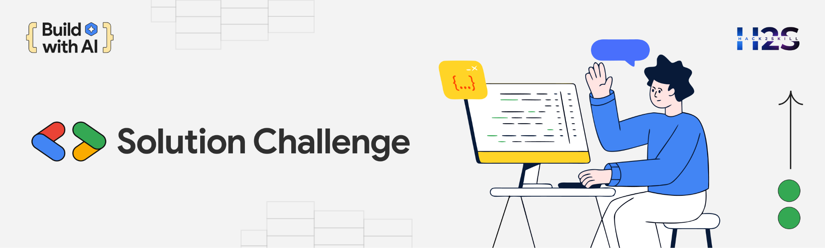
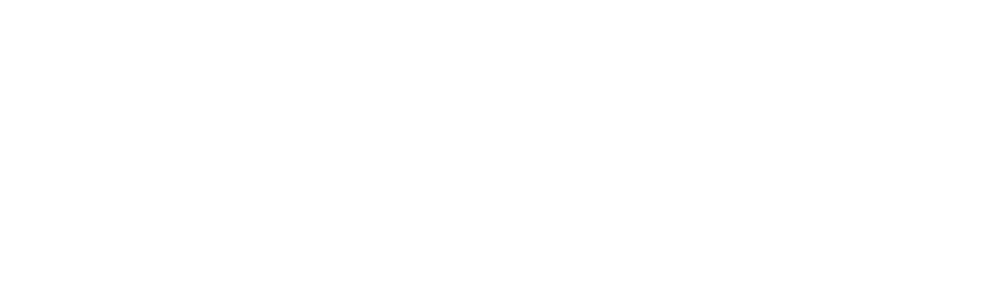
Team Details
  Team name:
  Team leader name:
  Problem Statement:

Slide 3
Brief about your solution

Slide 4
Opportunities
  How different is it from any of the other existing ideas?
  How will it be able to solve the problem?
  USP of the proposed solution

Slide 5
List of features offered by the solution

Slide 6
Process flow diagram or Use-case diagram

Slide 7
Wireframes/Mock diagrams of the proposed solution (optional)

Slide 8
Architecture diagram of the proposed solution

Slide 9
Technologies to be used in the solution

Slide 10
Estimated implementation cost (optional)

Slide 11
Snapshots of the MVP

Slide 12
Additional Details/Future Development (if any)

Slide 13
Provide links to your:
GitHub Public Repository
Demo Video Link (3 Minutes)
MVP Link
Working Prototype Link

Slide 15
